Slide 1


Advanced
Data Cleaning Techniques for Data Scientists
Welcome to this comprehensive guide on advanced data cleaning techniques for data scientists and analysts. In the world of big data, ensuring the quality and integrity of your datasets is paramount. This presentation will delve into sophisticated methods for detecting and treating outliers, normalizing and standardizing data, and provide hands-on practice with real-world datasets.
We'll explore cutting-edge approaches that go beyond basic data cleaning, equipping you with the tools to handle complex data challenges. Whether you're working with financial models, scientific research, or business analytics, these techniques will elevate the quality of your data and, consequently, the accuracy of your insights.
by Dr. Tri Basuki Kurniawan

Slide 2


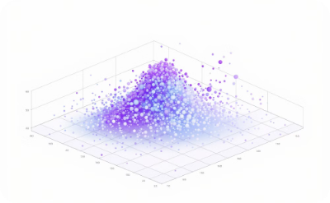

Understanding Outliers in Data Science
Definition of Outliers
Impact on Analysis
Types of Outliers
Detection Importance
Outliers are data points significantly deviating from other observations. They can arise due to measurement errors, rare events, or natural variability.
Outliers can skew statistical analyses, leading to biased results and incorrect conclusions. They affect measures of central tendency, variability, and relationships between variables.
Univariate outliers exist in a single variable, while multivariate outliers occur in the combination of two or more variables. Other classifications include point, contextual, and collective outliers based on their nature and occurrence.
Identifying outliers is crucial for maintaining data quality, improving model performance, and gaining insights into unusual patterns or behaviors.

Slide 3
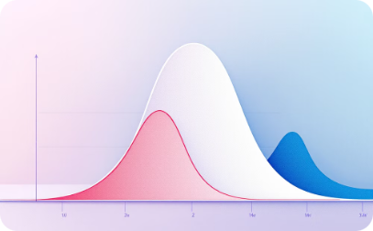

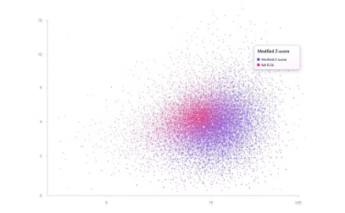
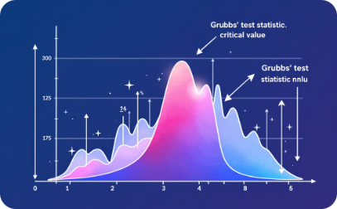
Statistical Methods for Outlier Detection
Z-Score Method
Interquartile Range (IQR) Method
Modified Z-Score
Grubbs' Test
The Z-score method calculates the number of standard deviations a data point is from the mean. Typically, points with a Z-score greater than 3 or less than -3 are considered outliers. This method is effective for normally distributed data but can be misleading for non-normal distributions.
The IQR method uses the concept of quartiles to identify outliers. Data points falling below Q1 - 1.5 * IQR or above Q3 + 1.5 * IQR are flagged as potential outliers. This method is robust and works well for skewed distributions.
The modified Z-score uses the median absolute deviation (MAD) instead of the mean and standard deviation. This makes it more robust to extreme outliers and suitable for non-normal distributions. Points with a modified Z-score greater than 3.5 or less than -3.5 are typically considered outliers.
Grubbs' test is a statistical test used to detect a single outlier in a univariate dataset that follows an approximately normal distribution. It calculates a test statistic and compares it to a critical value to determine if the most extreme value is a significant outlier.

Slide 4

Machine Learning Approaches to Outlier Detection
Isolation Forest
This unsupervised algorithm identifies outliers by randomly selecting features and split values, isolating anomalies with fewer splits.
Local Outlier Factor (LOF)
This density-based algorithm compares a point's local density to its neighbors, flagging points with significantly lower density as outliers.
One-Class SVM
This semi-supervised algorithm learns a decision boundary to distinguish new data as similar or different from the training set, useful when you have mostly normal data but few anomalies.

Slide 5

Treating Outliers: Removal vs. Transformation
Removal
Removing outliers is a straightforward approach but should be done cautiously. It's suitable when outliers are confirmed to be errors or when they significantly impact the analysis. However, removal can lead to loss of important information, especially in small datasets or when outliers represent rare but valid events.
Winsorization
Winsorization involves capping extreme values at a specified percentile of the data. For example, a 90% winsorization would set all data below the 5th percentile to the 5th percentile value and data above the 95th percentile to the 95th percentile value. This preserves the data points while reducing their extreme impact.
Log Transformation
Imputation
Applying a logarithmic transformation can help reduce the impact of outliers, especially in right-skewed distributions. It compresses the scale for larger values while spreading out smaller values. This can make the distribution more normal and reduce the influence of extreme values.
Instead of removing outliers, you can replace them with more typical values. Methods include mean/median imputation, regression imputation, or multiple imputation techniques. This approach maintains the original data size and can be useful when outliers are suspected to be errors.

Slide 6

Data Normalization: Scaling Features to a Common Range
Z-score Normalization
Min-Max Scaling
Robust Scaling
Unit Vector Scaling
Min-Max scaling, also known as normalization, scales all features to a fixed range, typically between 0 and 1. The formula is (x - min(x)) / (max(x) - min(x)). This method preserves zero values and maintains the original distribution of the data. It's sensitive to outliers but useful when you need bounded values.
Z-score normalization (or standardization) transforms the data to have a mean of 0 and a standard deviation of 1. The formula is (x - mean(x)) / std(x). This method is less affected by outliers compared to min-max scaling and is useful when you don't need a bounded range.
Robust scaling uses statistics that are robust to outliers. It subtracts the median and scales the data according to the interquartile range (IQR). The formula is (x - median(x)) / IQR(x). This method is particularly useful when your data contains significant outliers.
Unit vector scaling, also known as L2 normalization, scales the components of a feature vector so that the entire vector has a length of 1. It's calculated by dividing each component by the L2 norm of the vector. This method is often used in text classification and clustering problems.

Slide 7
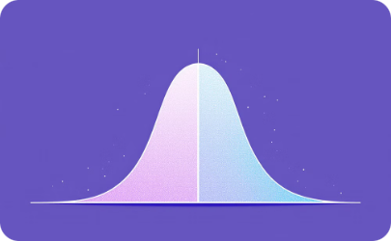
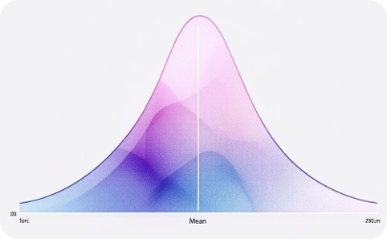
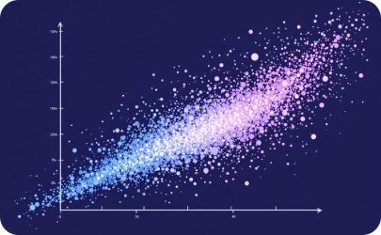
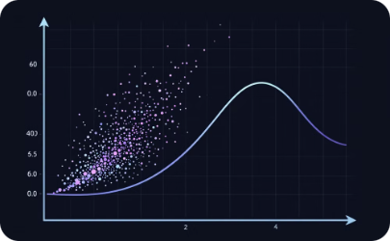
Data Standardization: Centering and Scaling
Mean Centering
Variance Scaling
Median and MAD Scaling
Quantile Transformation
Mean centering involves subtracting the mean value of a feature from all its data points. This shifts the distribution of the feature to be centered around zero. It's often the first step in standardization and can help in interpreting coefficients in linear models.
Variance scaling divides each centered feature by its standard deviation. This ensures that all features have a variance of 1. Combined with mean centering, this produces standardized features with zero mean and unit variance, which is crucial for many machine learning algorithms.
For data with outliers, using the median for centering and the median absolute deviation (MAD) for scaling can be more robust. This method is less influenced by extreme values and can provide a more reliable standardization for skewed distributions.
Quantile transformation scales the features to follow a uniform or normal distribution. This non-linear transformation can be useful for handling outliers and making the distribution of each feature identical, which can improve the performance of some machine learning algorithms.

Slide 8
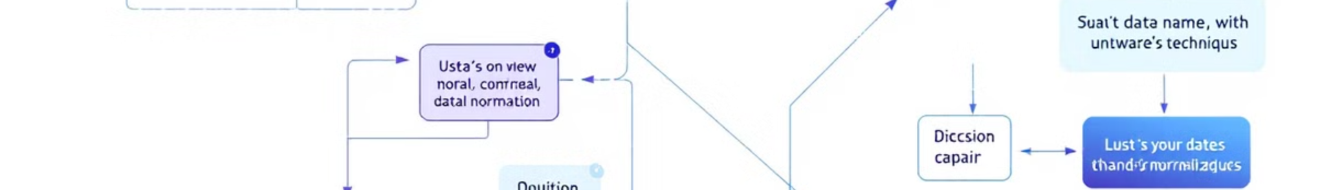
Choosing the Right Normalization or Standardization Technique
Technique
Use Case
Advantages
Disadvantages
Min-Max Scaling
When you need values in a
bounded interval
Preserves zero values, keeps
original distribution
Sensitive to outliers
Z-score Normalization
When outliers are present,
or for algorithms assuming
normal distribution
Less affected by outliers,
centers data around zero
Doesn't produce bounded
values
Robust Scaling
When data has many
outliers
Resistant to outliers, works
well with skewed data
May not be suitable for
normally distributed features
Unit Vector Scaling
Text classification, clustering,
neural networks
Useful for sparse data,
focuses on relative
proportions
Loses absolute magnitude
information

Slide 9
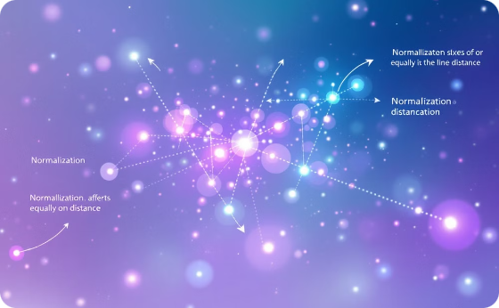

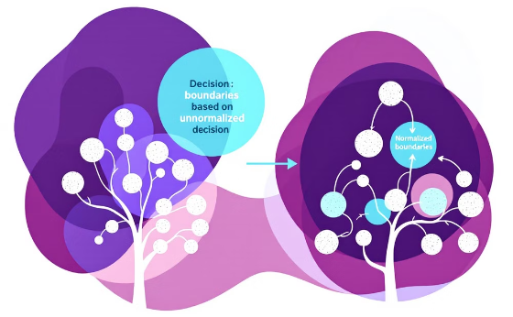
Impact of Normalization and Standardization on Machine Learning Models
Distance-Based Algorithms
Gradient Descent Optimization
Tree-Based Models
Algorithms like K-Nearest Neighbors (KNN) and K-Means clustering are highly sensitive to the scale of features. Normalization or standardization is crucial for these methods to ensure that all features contribute equally to the distance calculations. Without scaling, features with larger magnitudes would dominate the model's decisions.
For algorithms that use gradient descent optimization, such as neural networks and logistic regression, standardization can lead to faster convergence. When features are on similar scales, the optimization landscape becomes more uniform, allowing for larger learning rates and potentially quicker training times.
Decision trees and ensembles like Random Forests are generally invariant to feature scaling. However, normalization can still be beneficial for interpretation and visualization purposes. In some cases, it may also improve the model's performance, especially when dealing with regularized tree-based models.

Slide 10
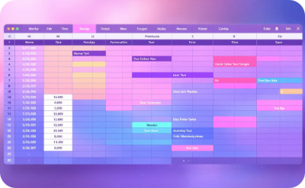
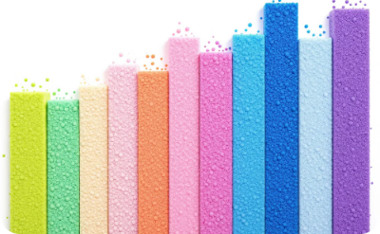
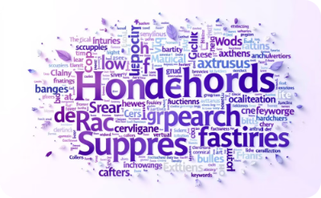

Handling Mixed Data Types in Normalization
Numerical Features
Categorical Features
Text Data
Date and Time Features
Apply standard normalization techniques like min-max scaling or z-score normalization. Consider the distribution and presence of outliers when choosing the method.
Use one-hot encoding for nominal categories. For ordinal categories, consider ordinal encoding or target encoding. Ensure that the encoded features are on a similar scale to the normalized numerical features.
Apply text-specific normalization techniques such as TF-IDF (Term Frequency-Inverse Document Frequency) or word embeddings. These methods inherently normalize text data to be compatible with numerical features.
Extract relevant components (e.g., day of week, month, year) and treat them as either numerical or categorical features. Consider cyclical encoding for periodic features like days or months.

Slide 11

Real-World Dataset: Financial Time Series
1
Data Description
Our dataset consists of daily stock prices for a tech company over the past 5 years. It includes features such as opening price, closing price, high, low, and trading volume. The data exhibits high volatility and several outliers due to market events.
2
Outlier Detection
We'll use the Interquartile Range (IQR) method to identify outliers in the daily returns. This method is robust to the non-normal distribution often seen in financial data. We'll focus on returns that fall below Q1 - 1.5 * IQR or above Q3 + 1.5 * IQR.
3
Outlier Treatment
Instead of removing outliers, which could represent important market events, we'll use winsorization. We'll cap the extreme values at the 1st and 99th percentiles, preserving the data points while reducing their impact on our analysis.
4
Normalization
For the price data, we'll use min-max scaling to bring all values between 0 and 1. This will allow us to compare price movements across different stocks easily. For trading volume, we'll apply a log transformation followed by z-score normalization to handle its typically right-skewed distribution.

Slide 12




Hands-On: Applying Techniques to Financial Data
Data Loading and Exploration
Outlier Detection and Treatment
Feature Normalization
Visualization and Validation
Begin by loading the financial time series data using pandas. Perform initial exploratory data analysis, including summary statistics and visualizations. Look for patterns, trends, and potential anomalies in the data.
Implement the IQR method to detect outliers in daily returns. Use numpy and pandas to calculate quartiles and identify extreme values. Apply winsorization using scipy.stats.mstats.winsorize() function to cap the outliers at specified percentiles.
Use sklearn.preprocessing. MinMaxScaler for price data normalization. For trading volume, apply numpy.log() for log transformation, then use sklearn.preprocessing.StandardScaler for z-score normalization. Ensure all features are on comparable scales.
Create before-and-after visualizations using matplotlib or seaborn to showcase the effects of outlier treatment and normalization. Validate the results by comparing summary statistics and distribution plots of the original and processed data.

Slide 13




Group Activity: Collaborative Data Cleaning Challenge
Dataset Introduction
Team Formation and Task Assignment
Collaborative Cleaning Process
Presentation and Peer Review
Participants will receive a complex e-commerce dataset with data quality issues.
Form teams of 3-4 and focus on cleaning specific dataset aspects.
Teams will collaborate using tools like Jupyter Notebooks or Google Colab to clean and normalize the data.
Teams will present their cleaned data, explain their methodology, and share best practices with peers.

Slide 14


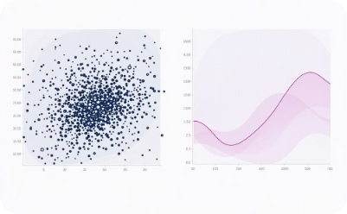

Best Practices for Advanced Data Cleaning
Document Everything
Automate Wisely
Visualize Before and After
Iterate and Refine
Maintain detailed records of all data cleaning steps, including the rationale for decisions made. This ensures reproducibility and helps in communicating the process to stakeholders or when revisiting the analysis later.
Develop reusable scripts or functions for common cleaning tasks, but be cautious about fully automating the process. Always include checks and balances, and review the results of automated cleaning to catch any unintended consequences.
Use data visualization techniques to compare the dataset before and after cleaning. This helps in identifying any unexpected changes and ensures that the cleaning process hasn't introduced new biases or errors into the data.
Data cleaning is often an iterative process. Be prepared to revisit and refine your cleaning steps as you gain more insights into the data or as new issues are discovered during analysis.

Slide 15

Conclusion and Future Directions in Data Cleaning
We've explored advanced methods for outlier detection and treatment, including statistical approaches and machine learning techniques. We've also covered various normalization and standardization methods, understanding their impact on different types of analyses and machine learning models.
The future of data cleaning is moving towards more automated and intelligent systems. Machine learning models are being developed to detect anomalies and suggest cleaning strategies. Natural Language Processing (NLP) techniques are improving the cleaning of text data, while computer vision advances are enhancing image data preprocessing.
As data becomes more complex and diverse, it's crucial to stay updated with the latest tools and techniques. Engaging in online courses, attending workshops, and participating in data science communities can help you stay at the forefront of data cleaning methodologies.

